Slide 2
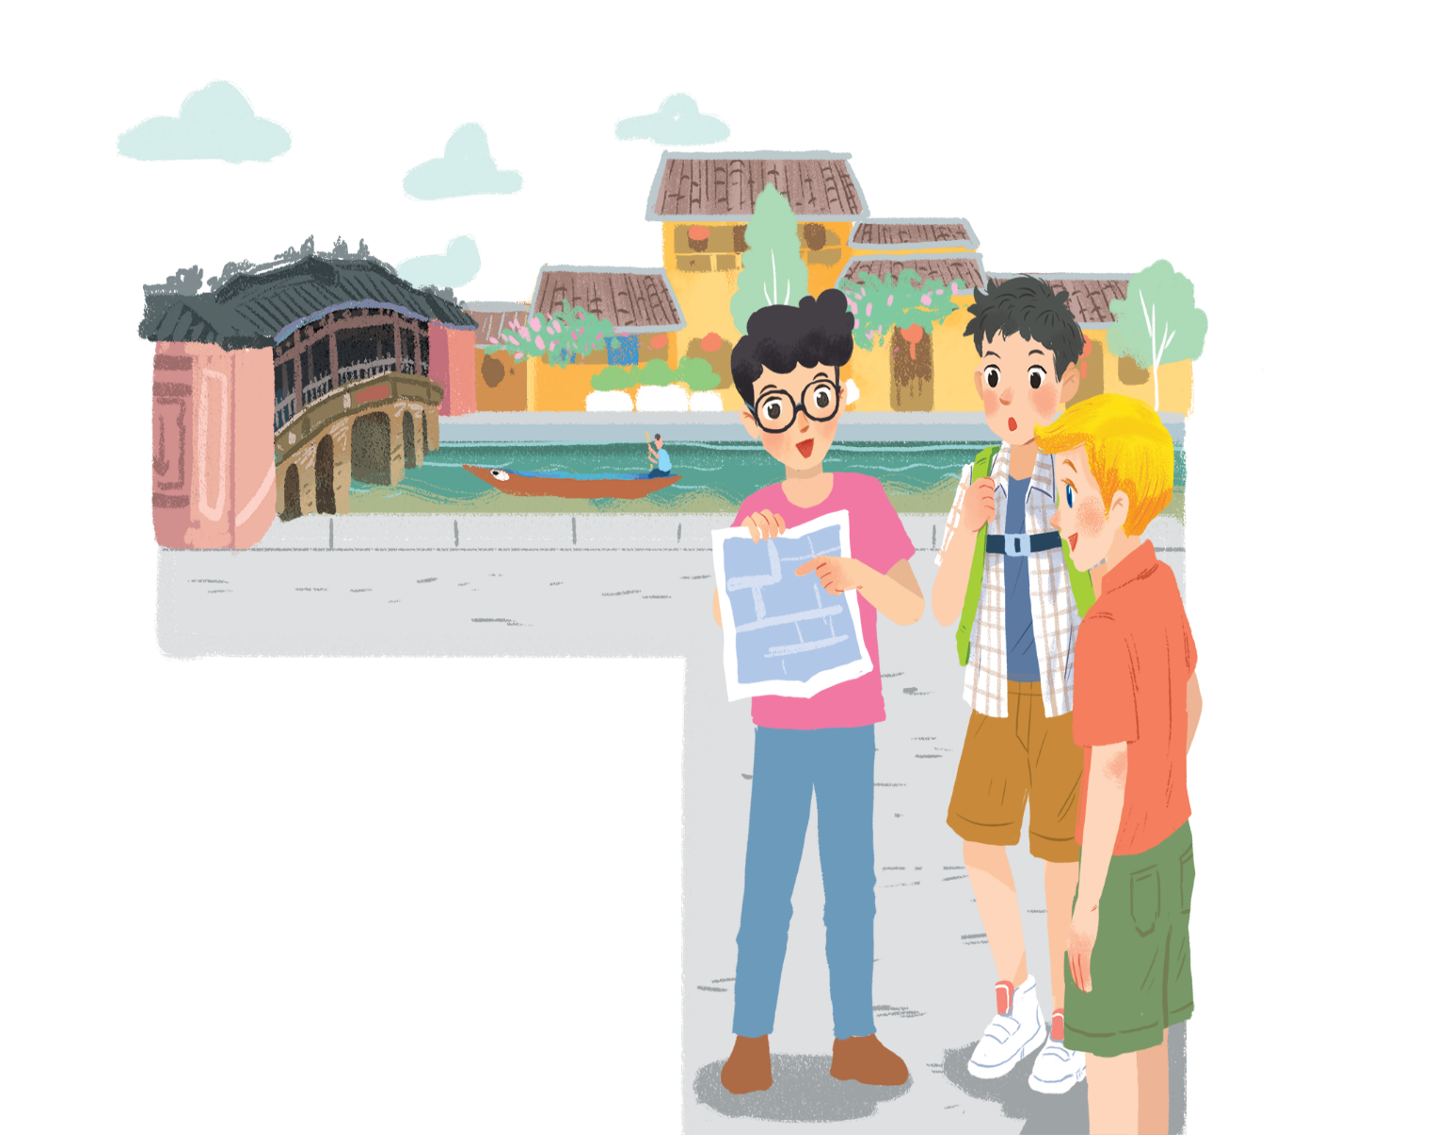
Friday , November 12rd, 2021
Unit 4. My neighbourhood
Lesson 1. Getting started

Slide 3

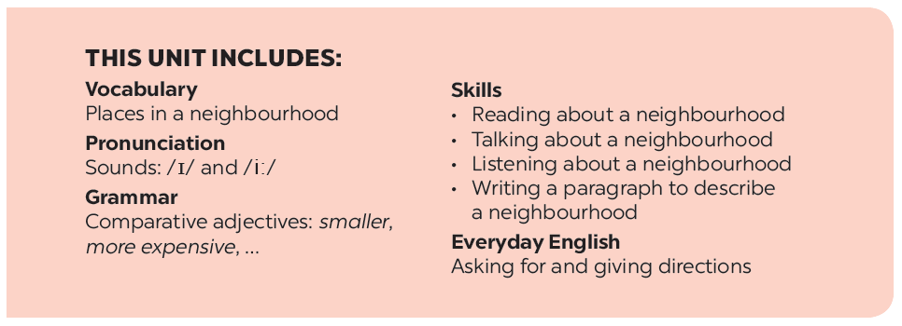

Slide 4








Lost in the old town!
Listen and read.
Find and underline the following directions in the conversation.
Find in the conversation the sentences used to make suggestions.
Find places
Read the conversation again. Put the actions in order.
Work in pairs. Give your partner directions to one of the places on the map, and he / she tries to guess. Then swap.

Slide 5


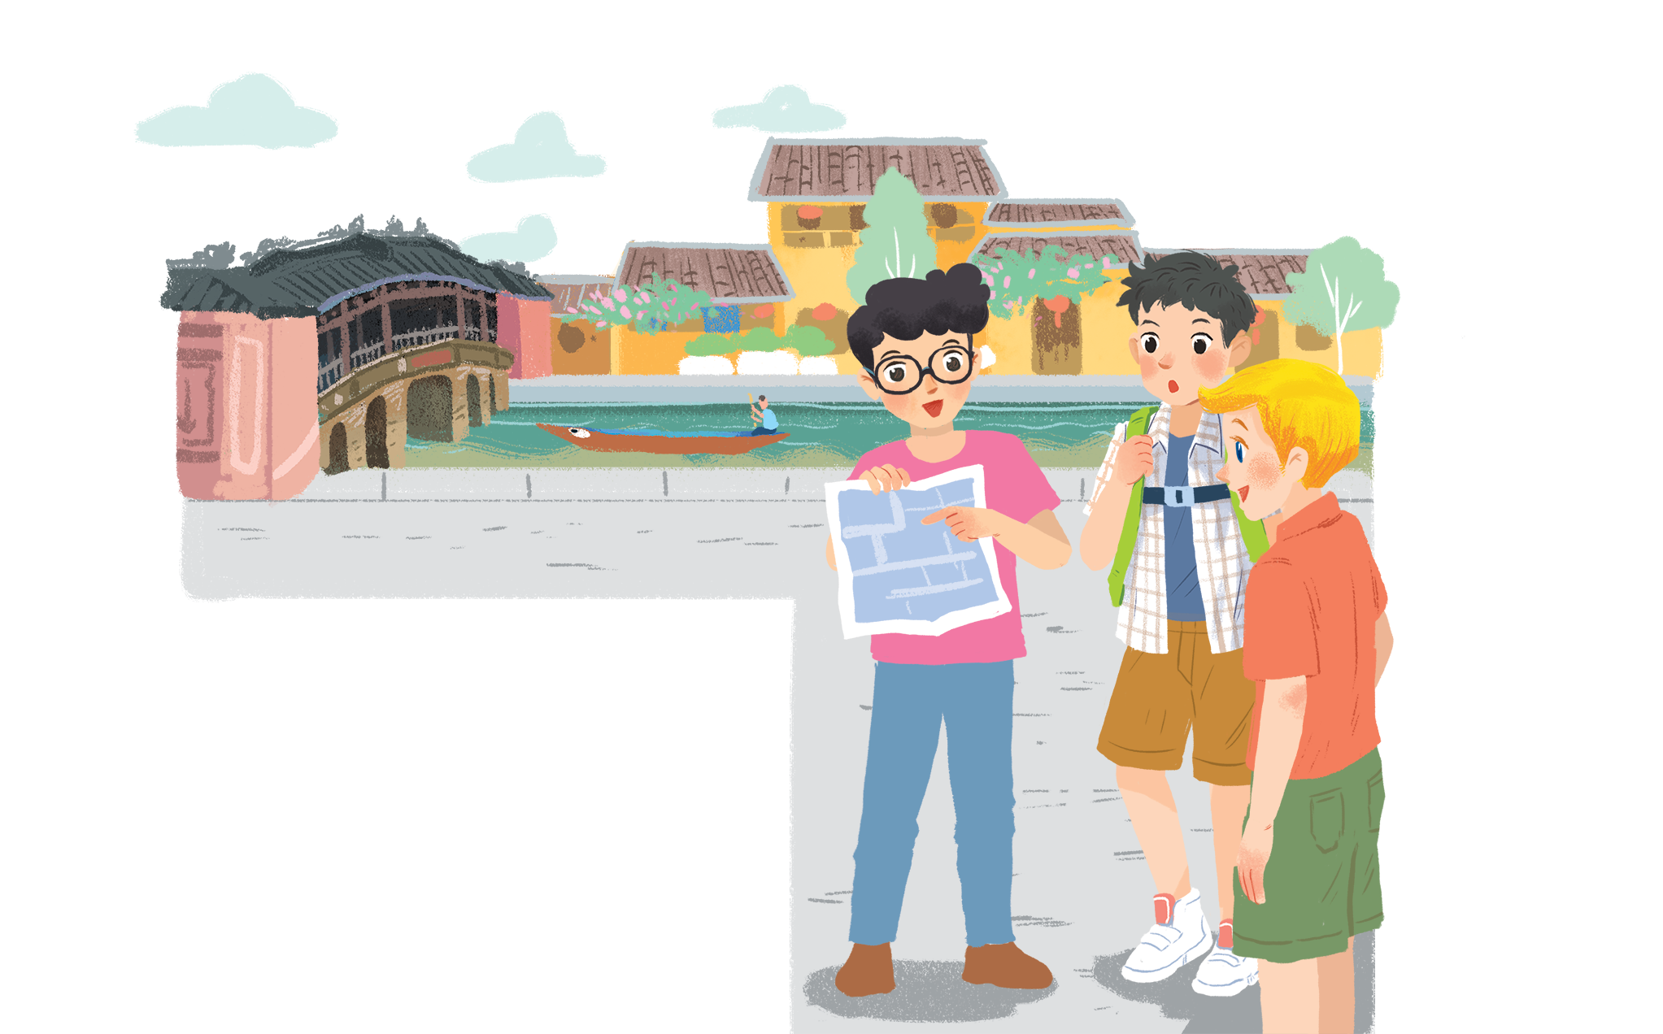
Listen and read.
Lost in the old town!
Notes:
.

Slide 6

Lost in the old town!
Phong: Wow! We’re in Hoi An. I’m so excited.
Nick: Me too. It’s so beautiful. Where shall we go first?
Khang: Let’s go to Chua Cau.
Phong: Well, but Tan Ky house is nearer. Shall we go there first?
Nick & Khang: OK, sure.
Phong: First, cross the road, and then turn left.
Nick: Fine, let’s go.
Phong: Wait.
Khang: What’s up, Phong?
Phong: I think we’re lost.
Nick: Look, there’s a girl. Let’s ask her.
Phong: Excuse me? Can you tell us the way to Tan Ky House?
Girl: Sure. Go straight. Take the second turning on the left, and then turn right.
Phong, Nick & Khang: Thank you.

Slide 7

Unit 4: MY NEIGHBOURHOOD
LESSON 1: GETTING STARTED
1. Vocabulary
- excited (adj):
Phấn khích, vui nhộn
- cross (v):
Đi qua, băng qua
- famous (adj):
nồi tiếng
- turn left >< turn right (v):
rẽ trái ><rẽ phải
- to be lost (v):
bị lạc
- go straight (v):
đi thẳng
* Grammar
Suggestion
Shall we ……?
Let’s + to(infi)…..
EX: Let’s go to Chua Cau.
Where shall we go first?

Slide 8

Find in the conversation the sentences used to make suggestions.
Example:
Let’s go to Chua Cau.

Slide 9
Lost in the old town!
Phong: Wow! We’re in Hoi An. I’m so excited.
Nick: Me too. It’s so beautiful. Where shall we go first?
Khang: Let’s go to Chua Cau.
Phong: Well, but Tan Ky house is nearer. Shall we go there first?
Nick & Khang: OK, sure.
Phong: First, cross the road, and then turn left.
Nick: Fine, let’s go.
Phong: Wait.
Khang: What’s up, Phong?
Phong: I think we’re lost.
Nick: Look, there’s a girl. Let’s ask her.
Phong: Excuse me? Can you tell us the way to Tan Ky House?
Girl: Sure. Go straight. Take the second turning on the left, and then turn right.
Phong, Nick & Khang: Thank you.

Slide 10

Find in the conversation the sentences used to make suggestions.
Example:
Let’s go to Chua Cau.
We can use shall we and let’s to make suggestions.

Slide 11

Read the conversation again.
Put the actions in order.
a.
The girl shows them the way to Tan Ky House.
5
b.
Nick, Khang and Phong arrive in Hoi An.
1
c.
Nick, Khang and Phong decide to go to Tan Ky House.
2
d.
Nick, Khang and Phong get lost.
3
e.
Phong asks a girl how to get to Tan Ky House.
4

Slide 12

Find and underline the following directions in the conversation.
A.
turn right
C.
turn left
E.
take the second turning on the left
B.
cross the road
D.
go straight

Slide 13
Lost in the old town!
Phong: Wow! We’re in Hoi An. I’m so excited.
Nick: Me too. It’s so beautiful. Where shall we go first?
Khang: Let’s go to Chua Cau.
Phong: Well, but Tan Ky house is nearer. Shall we go there first?
Nick & Khang: OK, sure.
Phong: First, cross the road, and then turn left.
Nick: Fine, let’s go.
Phong: Wait.
Khang: What’s up, Phong?
Phong: I think we’re lost.
Nick: Look, there’s a girl. Let’s ask her.
Phong: Excuse me? Can you tell us the way to Tan Ky House?
Girl: Sure. Go straight. Take the second turning on the left, and then turn right.
Phong, Nick & Khang: Thank you.

Slide 14


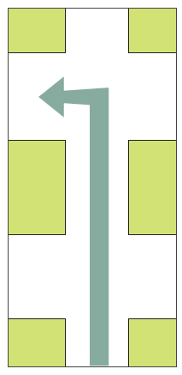

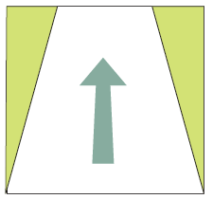
Now match these directions with the diagrams below.
1
turn right
2
3
take the second turning on the left
cross the road
turn left
5
4
go straight
A.
turn right
C.
turn left
E.
take the second turning on the left
B.
cross the road
D.
go straight

Slide 15

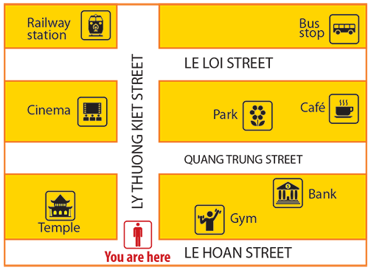
Find places
Work in pairs. Give your partner directions to one of the places on the map, and he / she tries to guess. Then swap.
Example:
A: Go straight. Take the second turning on the left. It’s on your right.
B: Is that the gym?
A: No, try again.

Slide 17
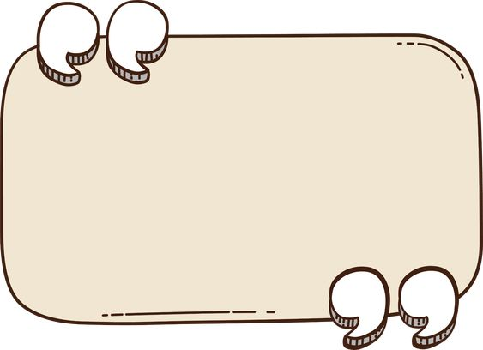
Homework
- Learn by heart the new words.
- Prepare lesson 2 A closer look 1

Slide 18







